Slide 1
Year 3 | Week 4 | Day 1

Slide 2
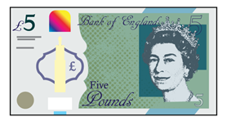
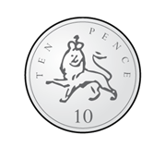
Year 3 | Week 4 | Day 2

Slide 3
Year 3 | Week 4 | Day 3

Slide 4
Year 3 | Week 4 | Day 4

Slide 5
Year 3 | Week 4 | Day 5

